Slide 1
Christ Covenant Church Mercy Minute
Deuteronomy 15:11"For there will never cease to be poor in the land. Therefore I command you, 'You shall open wide your hand to your brother, to the needy and to the poor, in your land.'

Slide 2
Introduction/Overview
Many new faces in congregation
Some not aware of mercy ministries
Confusion about various ministries
This presentation will cover
How CCC has Always Distributed Mercy
Why we do mercy
Who we help

Slide 3
Introduction/Overview Cont.
How we are able to fund this
How mercy is distributed
Mercy ministries explained
Mercy distributions YTD
How to donate
How to request mercy assistance
Deacon contact info
How to get involved or questions

Slide 4
CCC has Always Distributed Mercy
Congregation member support
Sister churches
Local community
Disaster relief organizations
Personal experience

Slide 5
Why Christ Covenant Does Mercy
Christ commanded us care for the poor
Luke 3:10-11; And the crowds asked him, “What then shall we do?” And he answered them, “Whoever has two tunics is to share with him who has none, and whoever has food is to do likewise.”
CCC is a gospel community in word and deed
Share the gospel, talk about the love of Christ
Show the love of Christ by caring for physical needs
Much more powerful

Slide 6
Why Christ Covenant Does Mercy cont.
James 2:14-17 "Suppose a brother or a sister is without clothes and daily food. If one of you says to them, 'Go in peace; keep warm and well fed,' but does nothing about their physical needs, what good is it? In the same way, faith by itself, if it is not accompanied by action, is dead.“
Talk about the love of Christ & show it

Slide 7
Who We Help
Our congregation first
Less need here, especially prior to pandemic
3 sister churches – Naples, Ft. Lauderdale, Miami
CCC planted these churches
Pastors attended Lamp Seminary
Very poor congregations
Historically, 150 families in need
Largely employed by service industry

Slide 8
Who We Help cont.
Local community
Outreach – walk-ins
Friends/neighbors of church members
2 Hope Women’s Centers – Ft. Lauderdale
Free pregnancy tests
Counseling – Benefits acquisition assistance
Alternative to abortion in a non-judgmental, loving, & Christian way
Disaster relief organizations

Slide 9
How we are able to fund this
Exclusively through donations
Deacons maintain a mercy bank account
Separate from tithes/offerings
Alms for the poor/mercy
Very thankful for your generous donations/mercy support
God continuously blesses these mercy ministries
Amazed at what God does through our small church

Slide 10
How Mercy is Distributed
Our congregation
Financial support – as needed basis
Included in annual mercy projects – as needed basis
Sister churches
4 annual mercy projects
Easter – 2 bags of groceries, gift cards – 150 families
Back to school – back pack loaded with school supplies, gift cards – 150 families –Replaced by Compassion During Covid in 2020
Thanksgiving - 2 bags of groceries, gift cards – 150 families
Christmas – Little angels – gift for 150 – 175 children

Slide 11
How Mercy is Distributed cont.
Sister churches also receive
All proceeds from Martha Ministry
Additional financial support from General Mercy when available
Local Community
Hope Centers – included in 4 annual projects
Walk-ins – Case by case basis
Outreach/friends/neighbors – typically included in annual projects

Slide 12
How Mercy is Distributed cont.
Disaster relief organizations
MNA
Occasional financial support when funds available
Supplies
Water damage cleanup supplies
Toiletries
Diapers
Etc.

Slide 13
Mercy Ministries Explained
Ongoing mercy ministries
General Mercy account – Link always on website
Allows deacons to apply funds where most needed
Used to support congregation members first
Martha Ministry account – Link available indefinitely
Started in March - Provides financial relief to those in service industry affected by the pandemic
All proceeds go to 3 sister churches – Largely in service industry
Enables pastors to provide support where needed most

Slide 14
Mercy Ministries Explained cont.
Annual/Promotional Ministries
Easter/Back to School/Thanksgiving/Christmas
Link available approx. 2 months prior to event
Envelopes in worship packet weekly during season
Provides food and gift cards or Christmas gifts to sister churches, hope centers, and congregation members or local community members in need

Slide 15
Mercy Ministries Explained cont.
New Ministries
CompassionDuring COVID- Link available through October 10th
Replaces back to school ministry this year
Provides bulk food and financial support to sister churches
$6000.00 budgeted
Also asking for clothing donations
Bring items to church on Sundays or drop off with staff members during the week

Slide 16
Mercy Ministries Explained cont.
Christ Covenant Cupboard – Link available now
Brand new ministry for CCC!
Local community members can drive-thru our parking lot for food distribution in CCC logo bags
Bags will contain food, church information pamphlet, a gospel tract and a bible
Spread the gospel and help physical needs
Targeting 100 families – $3000.00
Deacons contributing $2000.00 – hope to raise $1000.00 more
Targeting mid to late October event date

Slide 17
Mercy Distributions - YTD
Direct financial support to congregation members
General Mercy Account - $6,900.00
Direct financial support to sister churches
Martha Ministry - $12,237.00
General Mercy Account - $5,000.00
Food/Gift Cards to sister churches/Hope Centers
Easter Mercy Project
$2,700.00 – Bulk food
$6,000.00 - $40 gift card to 150 families

Slide 18
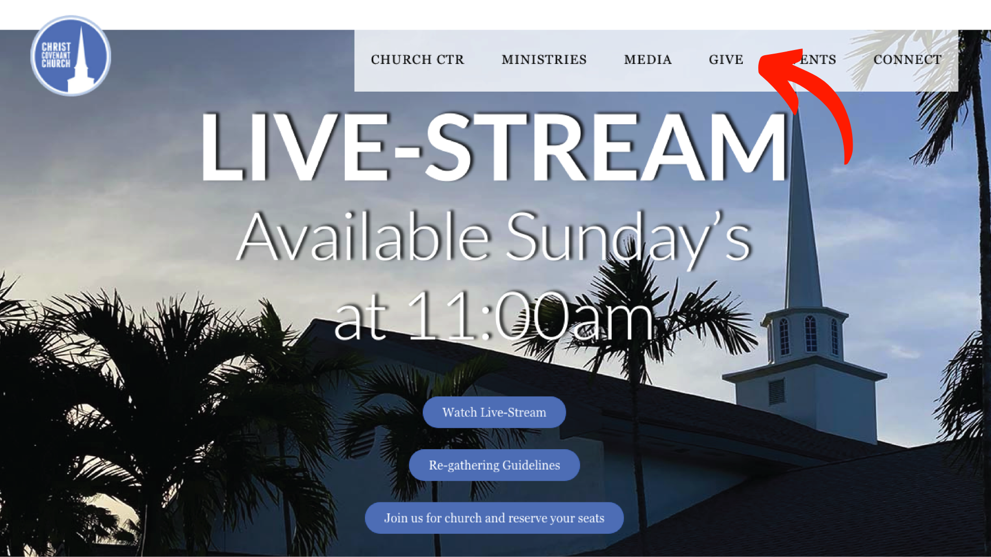
How to Donate
Website – christcovenant.cc
Click on GIVE

Slide 19
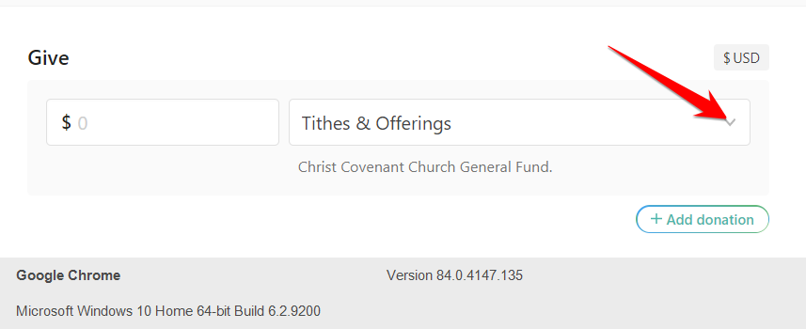
How to Donate cont.
Click on arrow to get drop down menu

Slide 20
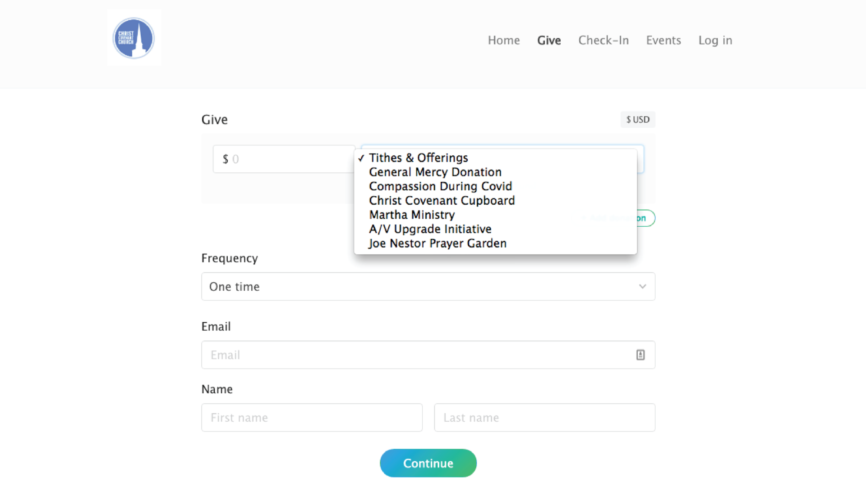
How to Donate cont.
Select ministry you wish to donate to and complete transaction

Slide 21
How to Donate cont.
Check
Write desired ministry in memo section
Cash
Insert in mercy envelope and indicate desired ministry
Items to note
100% goes to specified ministry
All donations are tax deductible
If specific ministry is not specified it will be applied to General Mercy

Slide 22
How to Request Mercy
Reach out to any church officer
Pastor Brian
Any Elder
Any Deacon
Help is confidential
Testimonials are voluntary – Not required or expected
Let us share your burden
If we don’t know, we can’t help

Slide 23
Deacon Contact Info
Deacons
Mike Porter
Diaconate Chairman, Mercy Coordinator
954-817-7838
Joe Ducsay
Treasurer, Lord’s Supper Coordinator
954-589-7352
Victor Gonzalez
Property Coordinator
954-559-0276
Deacon Interns
Edwin Negron
Community Mercy
954-702-4301
Jerry McMurray
Secretary
954-547-7613
Chase Pepper
Worship Life
954-599-0170

Slide 24
Information on Getting involved or Mercy Questions?
Questions on this presentation or general mercy questions
Contact Mike Porter
954-817-7838 - Call or text
Email at mpinstl@hotmail.com
Interested in getting involved?
Contact any deacon for information – phone numbers on previous slide
email at deacons@christcovenant.cc – goes to all deacons
Deacons are in entryway before and after service

